Slide 1

Scalable Ground-truth Annotation for Video QoE in Enterprise WiFi
Mallesh Dasari§, Shruti Sanadhya†‡, Christina Vlachou† ,
Kyu-Han Kim† , Samir R. Das§
§Stony Brook University, †HPE Labs, ‡Facebook
Stony Brook University
Notes:
Good afternoon everyone! So this work is about quality of experience modeling which was in collaboration with Hewlett Packard enterprise.

Slide 2
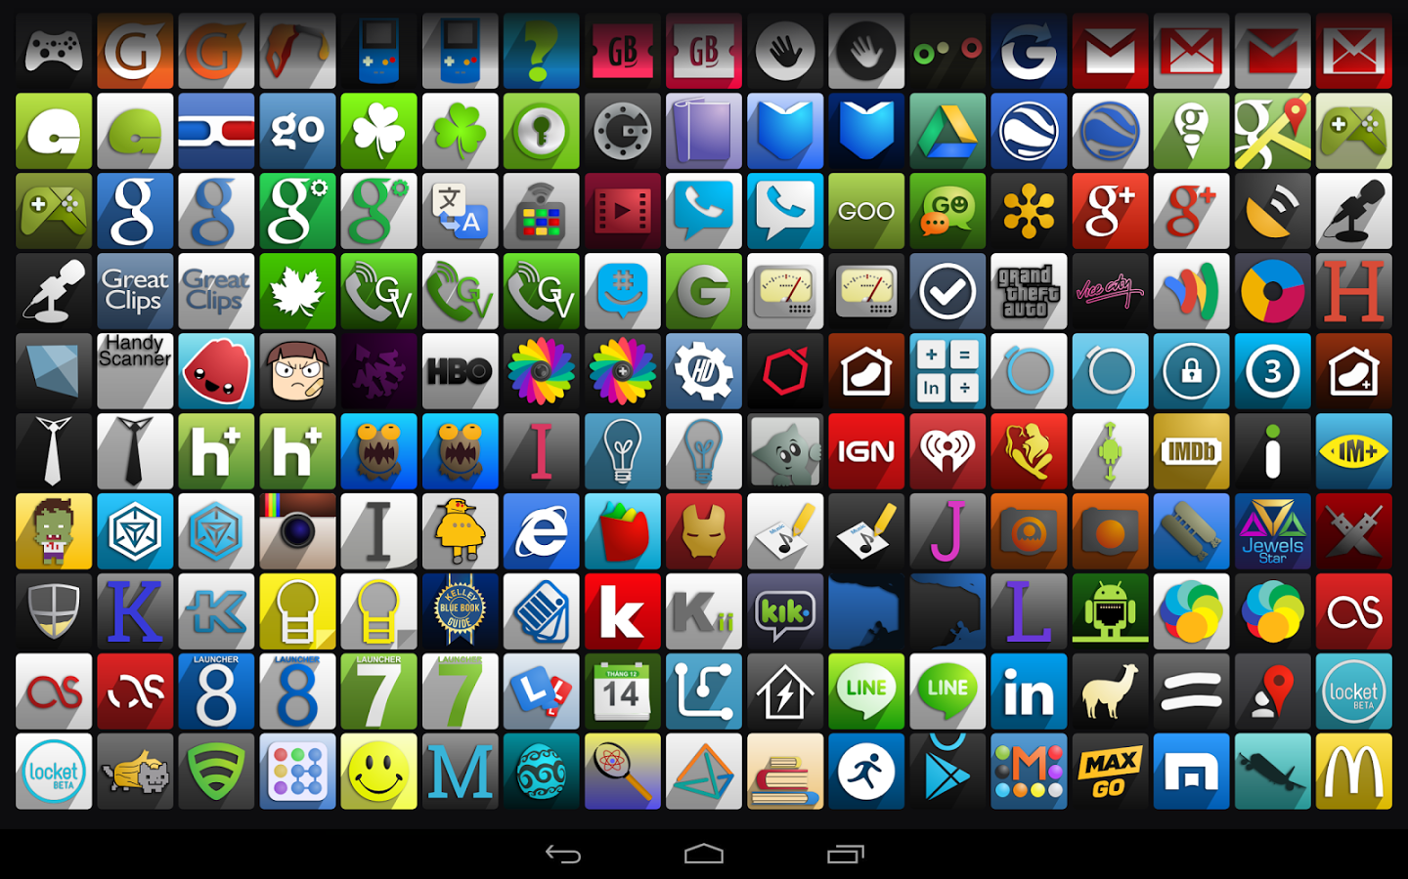
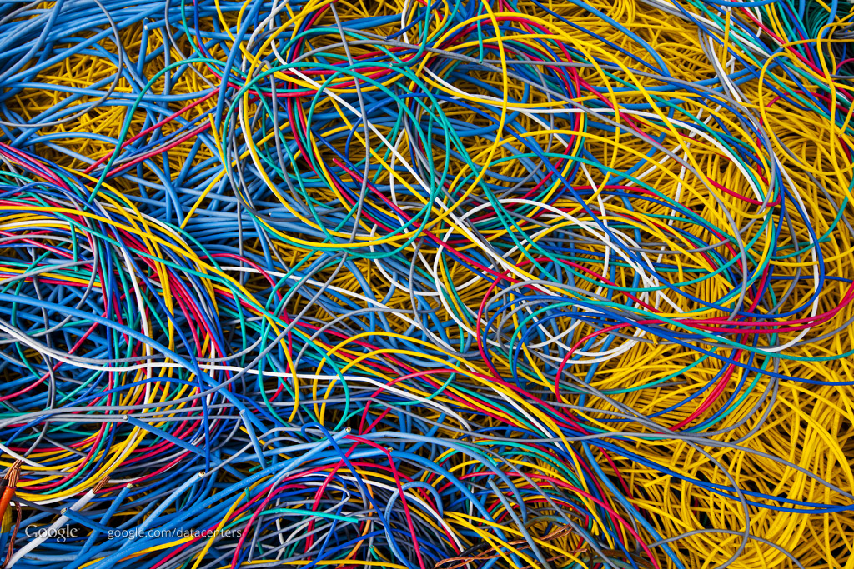
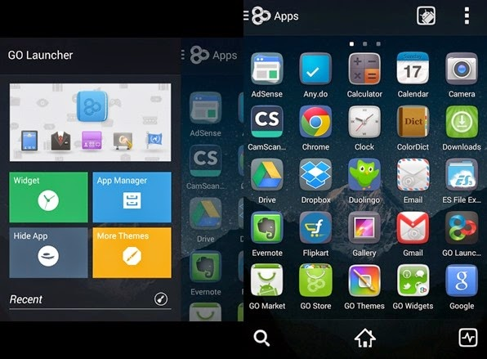
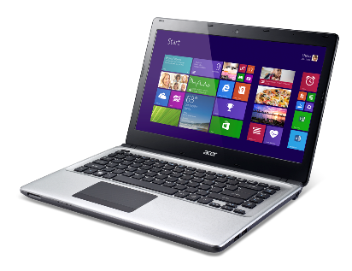
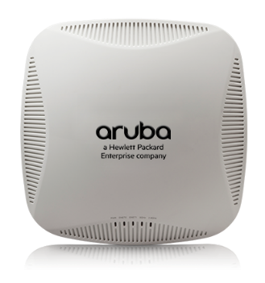
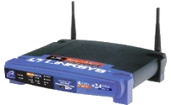
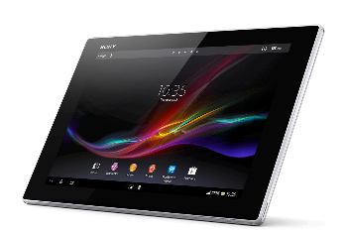


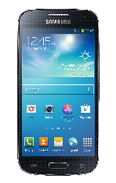

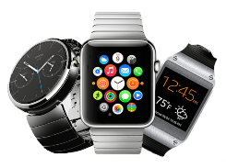
QoE-based Resource Control
Diverse Apps
Diverse Devices
Diverse Networks
Understanding QoE issues – Hard!
Notes:
So, there is lot of work to improve the QoE given that there are diverse applications, devices and networks. Because of these mixed technologies it has become very hard to understand the QoE issues and thereby improvement. The current solutions to improve QoE vary from application developers, device manufacturers and of course content providers.

Slide 3
QoE-based Resource Control
Diverse Apps
Diverse Devices
Diverse Networks
Understanding QoE issues – Hard!
Notes:
In this work, we will focus on QoE improvement at the last of hop of the network which is typically access points like Aruba and Netgear Aps that you see up there.

Slide 4








Network Resource Provisioning
Internet
QoE
QoS
$$QoE=α+βe^{−γ.QoS}$$
Training Mobile Device
QoE Model
IQX Hypothesis (Fielder et. al, IEEE TON Mar’2010)
Notes:
So currently, the last hop routers for example Aruba have no idea how the users experience is. But, recently it has been proven that QoE based network resource provisioning performs better than QoS. However, knowing the QoE from end-users is not feasible in real time, so some prior work mapped QoE based on QoS.

Slide 5


Network Resource Provisioning
Internet
$$QoE=M(QoS)$$
QoE
QoS
$$QoE=α+βe^{−γ.QoS}$$
Training Mobile Device
QoE Model
IQX Hypothesis (Fielder et. al, IEEE TON Mar’2010)
Notes:
We can train this experience under diverse network conditions using a machine learning model and use this data-driven QoE model in resource provisioning. So, Aruba which is acquired by HP wanted to make their WiFi AP intelligent by embedding the QoE of end-users and as an initial attempt we focus on modeling telephony applications. And there we face few challenges. This model here requires the ground-truth QoE information to map with QoS. But currently,

Slide 6
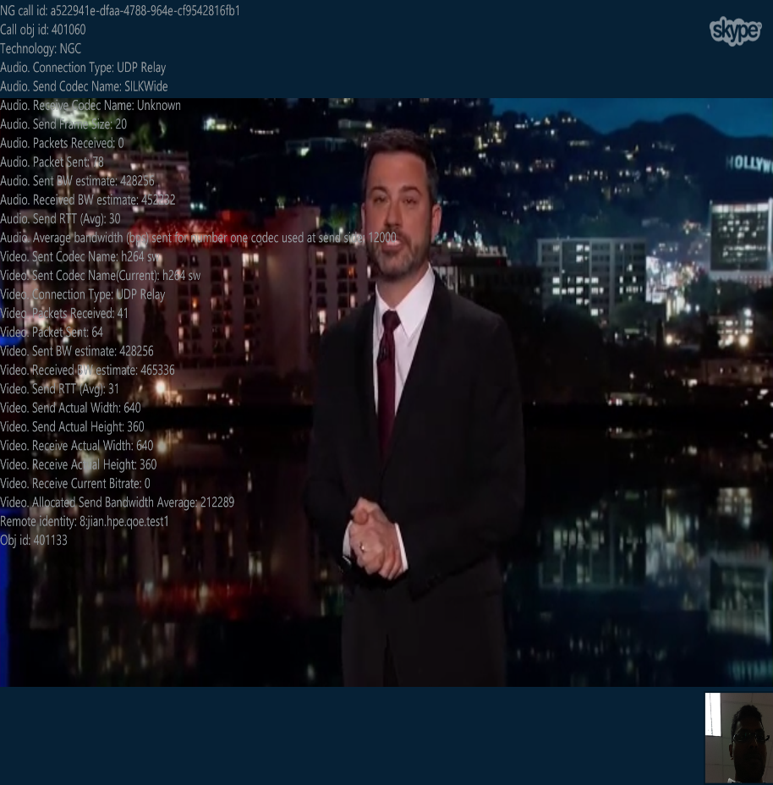


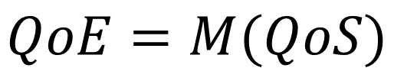
Problem
Lack of QoE information for
several applications
Application | QoE Information
Skype | (some versions)
Hangouts/Duo
Facetime
Skype Technical Info
$$QoE=M(QoS)$$
Notes:
Most of these applications does not provide any such QoE information. For example, Skype provides some sort of technical information during the call, which previously people used to model QoE but is not available on all versions especially recent versions. And, as you know, the training phase is very important for machine learning, which requires the ground-truth data.

Slide 7
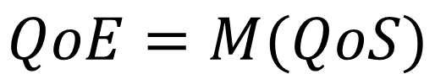
Problem
Lack of QoE information for
several applications
Application | QoE Information
Skype | (some versions)
Hangouts/Duo
Facetime
Skype Technical Info
$$QoE=M(QoS)$$
Can we assess the QoE
without any support from the application?
Notes:
So, we ask how to get this ground-truth QoE without any support from the application? This is especially important with massive increase in number of video applications.

Slide 8
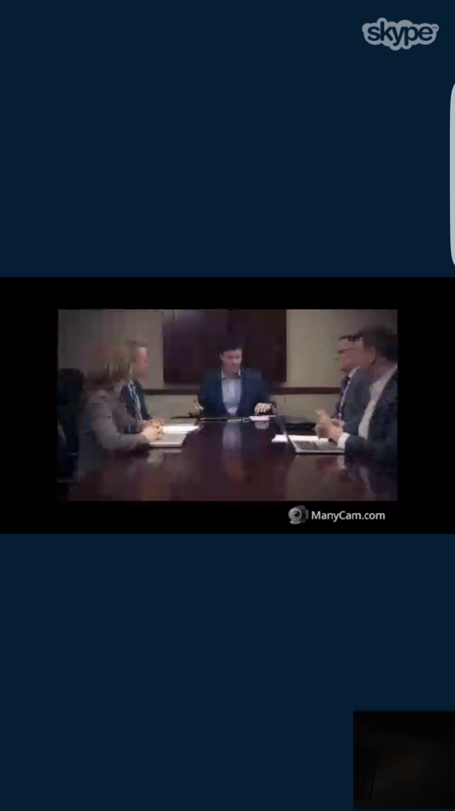
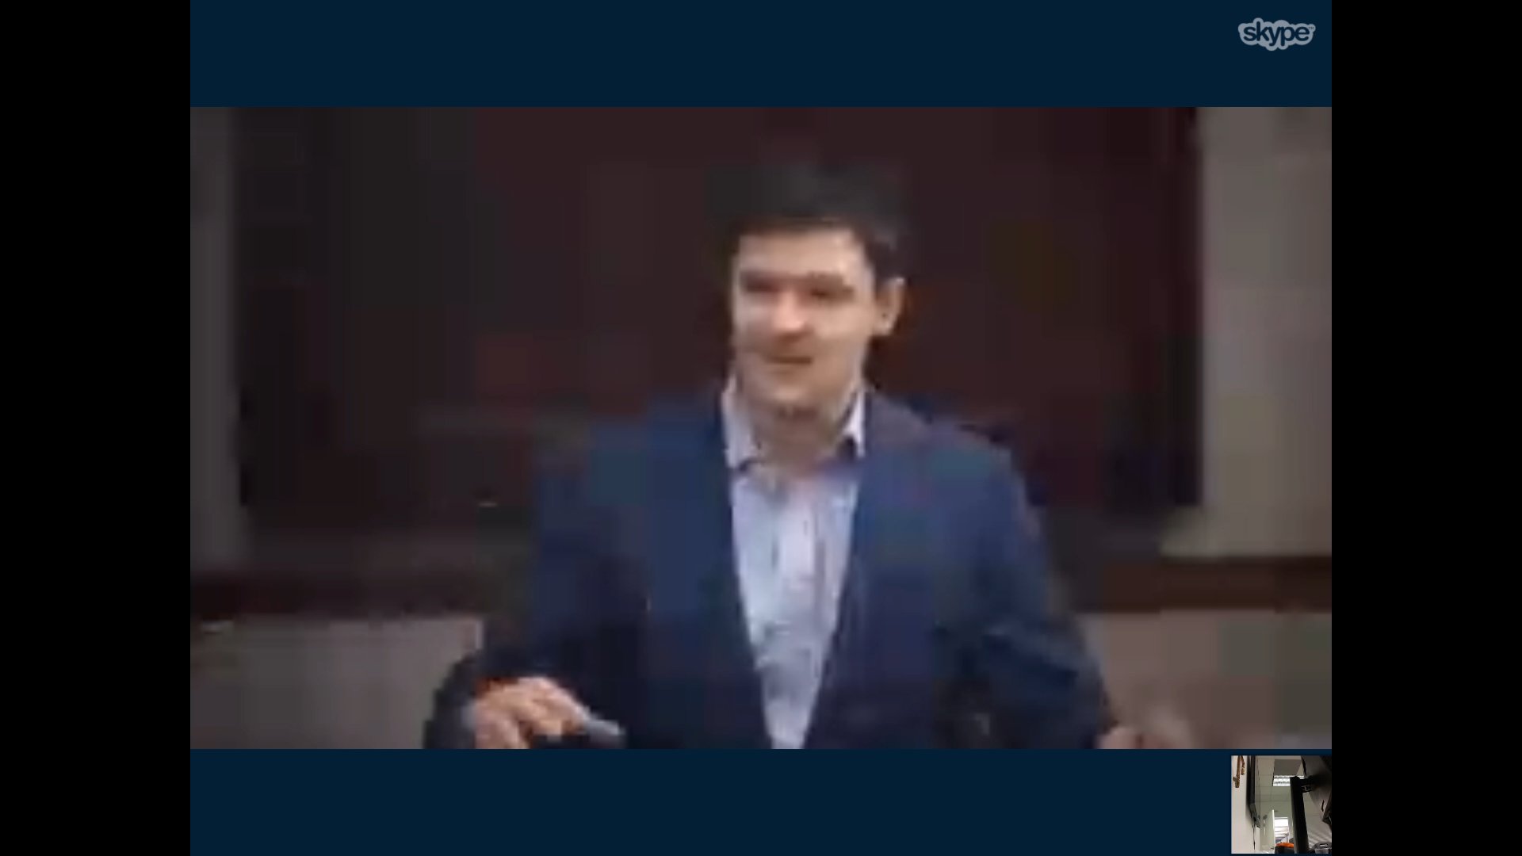
Video QoE Artifacts
Blurring effect (Spatial)
Freezes (Temporal)
QoE = f(Blur, Freezes)
We want to capture these artifacts
Notes:
So what exactly do we need to consider to while designing metrics. Here is a blurred image that screenshot under bad network conditions. Obviously, when we see the blurred image, our experience is not satisfactory. Similarly, you get bad experience when you see video freezes like this. So the aim is to capture these artefacts. Remember our goal: getting the ground-truth data for training the machine learning model? This is it.

Slide 9
Limitations of prior QoE Metrics
Similar behavior for temporal variation
1. X. Marichal, Wei-Ying Ma and HongJiang Zhang, "Blur determination in the compressed domain using DCT information," Springr 2016
Notes:
So, we tried few existing popular metrics to capture these QoE artifacts and found that they fail across diverse content and motion present in the video. As you see, the metric does not really distinguish a good quality and bad quality video.

Slide 10
System Design
Notes:
So here is our system design. We record the screen during the video call and extract the QoE artifacts offline. Finally, we map our QoE metrics to actual user’s experience scores using ML models which I will describe later.

Slide 11
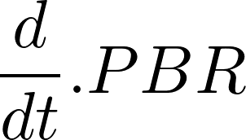
Our QoE Metrics
1. Perceived Bitrate (PBR)
3. Freeze Ratio
Ffmpeg’s mpdecimate
Similar to Inter-frame prediction
Typically video compression is very motion sensitive
Use intra only coding
4. Number of freezes
5. Length of freezes
2. cPBR( )
Number of unique frames
Total frames
Freeze Ratio = 1 -
Recorded video bitrate – Compressed video bitrate
Recorded video bitrate
PBR =
Notes:
Our first metric is perceived bitrate which is a modified version of video bitrate. To make it content agnostic, we take the percentage change in the recorded video bitrate and compressed video bitrate. We also take the gradient of this PBR metric as another metric to capture the influence of number of times the quality of video changes. Next,

Slide 12
MOS Prediction Model
User-study
MOS
Predict MOS
From QoE Metrics
QoE = M (Blur, Freezes)
Validate the QoE metrics by mapping them to actual
users’ experience
800 video samples from 20 diverse videos, 200 users
Notes:
We have several QoE metrics here. We validate these metrics by modeling with actual users experience. To this end, we conduct a user study to see the correlations between user perception and our metrics and to validate them. We conduct a user-study with both lab and online users on Amazon mechanical turk with a total of 200 users and 800 video clips. And,

Slide 13
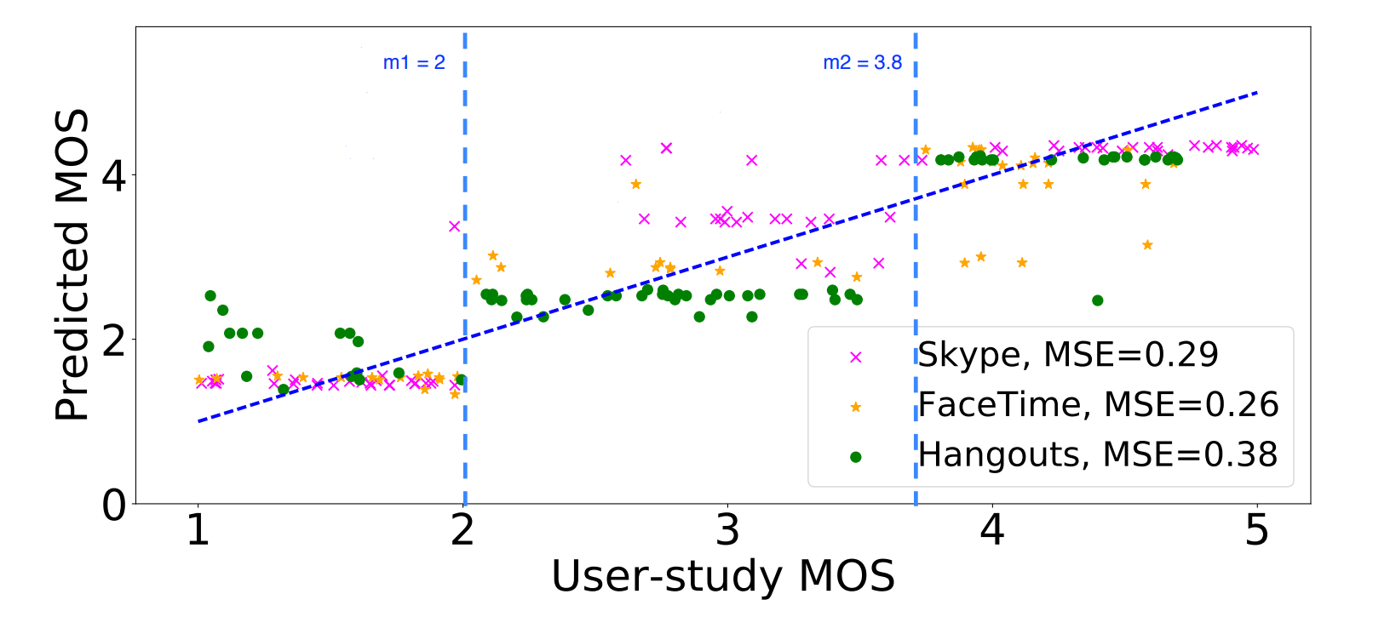
Results
A median of 90% accuracy for all three applications
Notes:
So, we wanted to classify the videos into 3 classes and hence had to find two thresholds to divide the users ratings into three classes. This threshold we select based on a greedy algorithm where we train the model with different thresholds and select the maximum accuracy giving thresholds. So with these two thresholds, we achieve a median of 90% accuracy for all three applications. And also, the mean squared error of the MOS is below 0.4 for all applications.

Slide 14
Results
Baseline has up to 1.4 MOS estimation error across 20 videos and hence failing to distinguish good /bad from average QoE
Notes:
We further compare our model with previous baseline model. The baseline model is created using the QoE metrics that I have shown in the beginning where they fail distinguish the quality of videos with diverse content. As you see, the MOS error goes till 1.4 with baseline model.

Slide 15
Results
Free Ratio is the most dominant feature
Notes:
Finally, we evaluate the feature importance for all three applications. We find that skype is more sensitive to freeze ratio while hangouts and facetime are almost equally sensitive to both PBR and freeze ratio. Where as the other features are not very important.

Slide 16
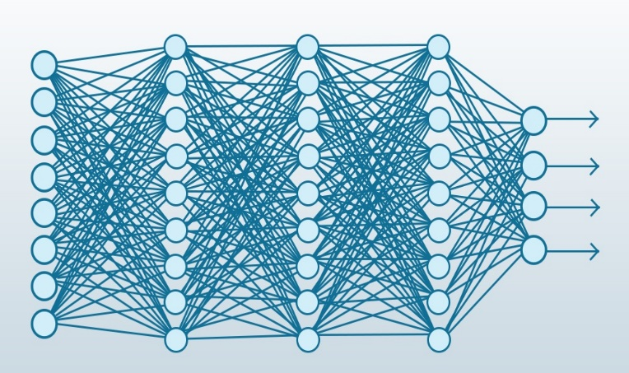
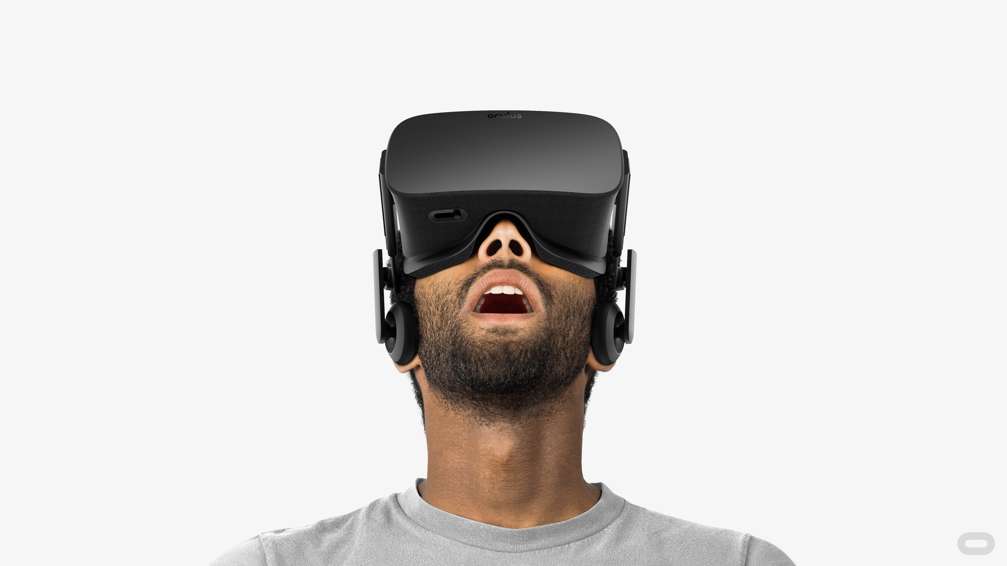
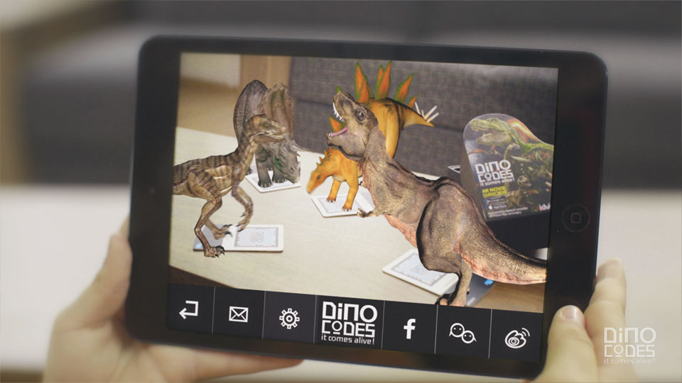

Ongoing and Future Work
Advanced learning and other applications
Thank You!

